Slide 1

LifeLens: Sleep Performance Analysis
Muhaiminul Ashraf
Northeastern University
College of Engineering
EECE2560: Fundamentals of Computer Engineering Algorithms
Fall 2024

Slide 2
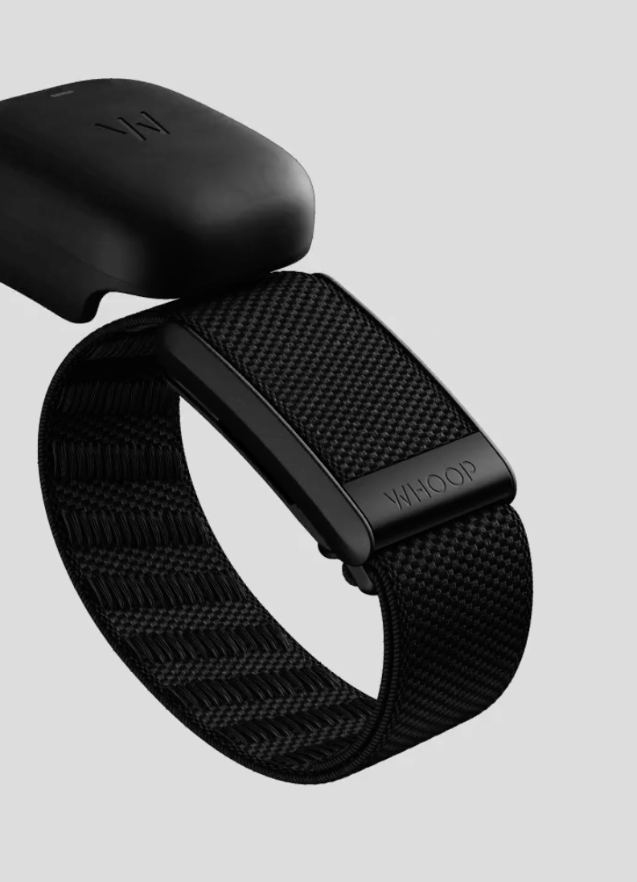
Introduction
Objectives:
Analyze sleep performance over the course of the night based on:
Light Sleep
Deep Sleep
REM Sleep
Visualize sleep patterns over a period of weeks/days to determine user’s sleep performance using python’s MATLAB library
Evaluate closeness of own algorithm’s sleep performance rating to WHOOP’s given performance rating
Notes:
So, before this semester began, I purchased a WHOOP to help me keep better track of my sleep habits. Whenever the semester starts ramping up, the first things I tend to sacrifice are my sleep habits and workout routines, consciously or subconsciously. Losing sleep and accumulating sleep debt, which is when your body gets less than 8 hours of sleep, has been shown to lead to issues with metabolism and is linked to a higher risk of developing Type 2 diabetes. As such, this semester I wanted to mitigate some of that. As I’ve been using WHOOP, I figured that the data processing and collection they do would be a viable project for me and would be useful in trying to emulate. So, my project attempts to do exactly that. I analyze sleep performance over the course of the night based on different phases of sleep and show the user statistics about their sleep patterns over the course of the night. I then attempt to get my own algorithm’s performance as close to WHOOP’s performance rating as possible to determine the factors that they use to determine a sleep score.

Slide 3
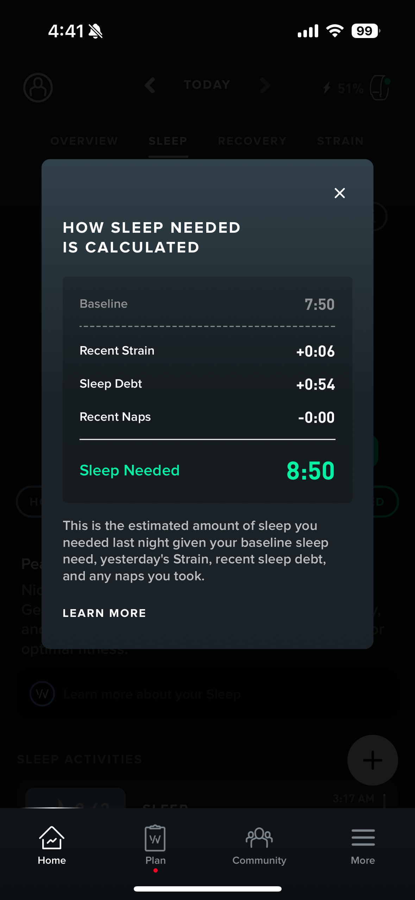
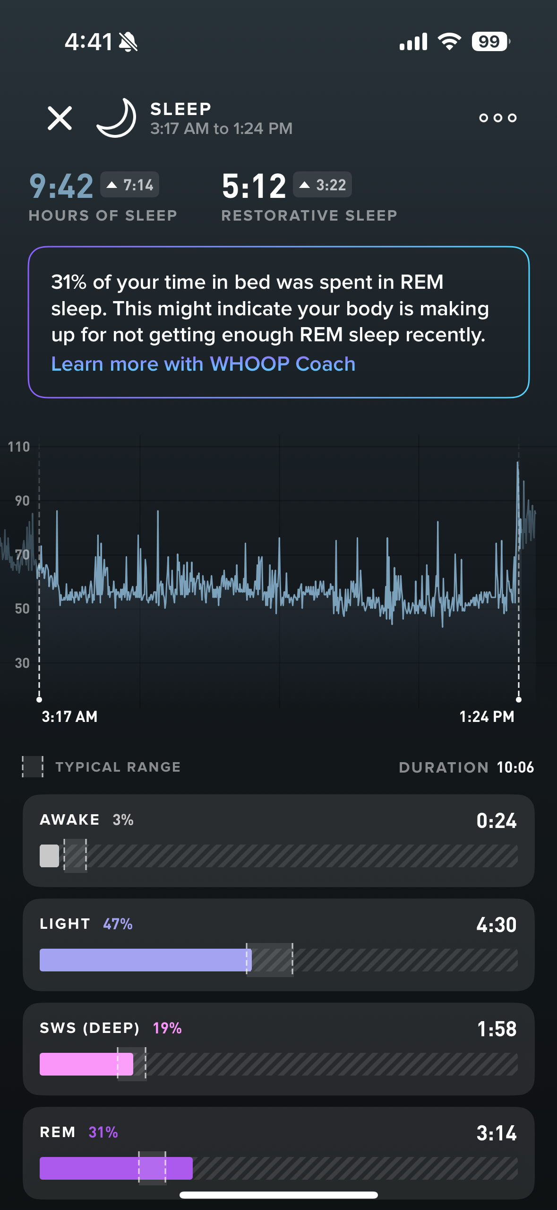
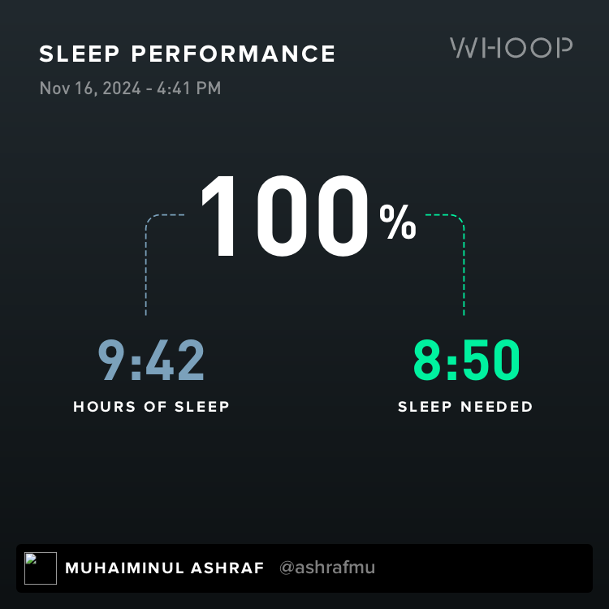
Existing Literature – Whoop sleep Performance Analysis
Notes:
This is what the software WHOOP presents to users currently looks like. As you can see, Whoop calculates your sleep performance based on several factors. Primarily your recent strain and sleep debt accumulated from previous days of lack of sleep. From these parameters, it can calculate your sleep need. It then rates your sleep performance based on how much you have slept versus your sleep need. If you have exceeded your sleep need, then you are rated at a performance of 100%. Whoop is also able to tell you how much of your sleep is spent in different states i.e. Awake phase, Light Sleep phase, SWS (Deep Sleep) Phase, and REM sleep phase based on readings from its hardware that tracks your heart rate throughout the night.

Slide 4
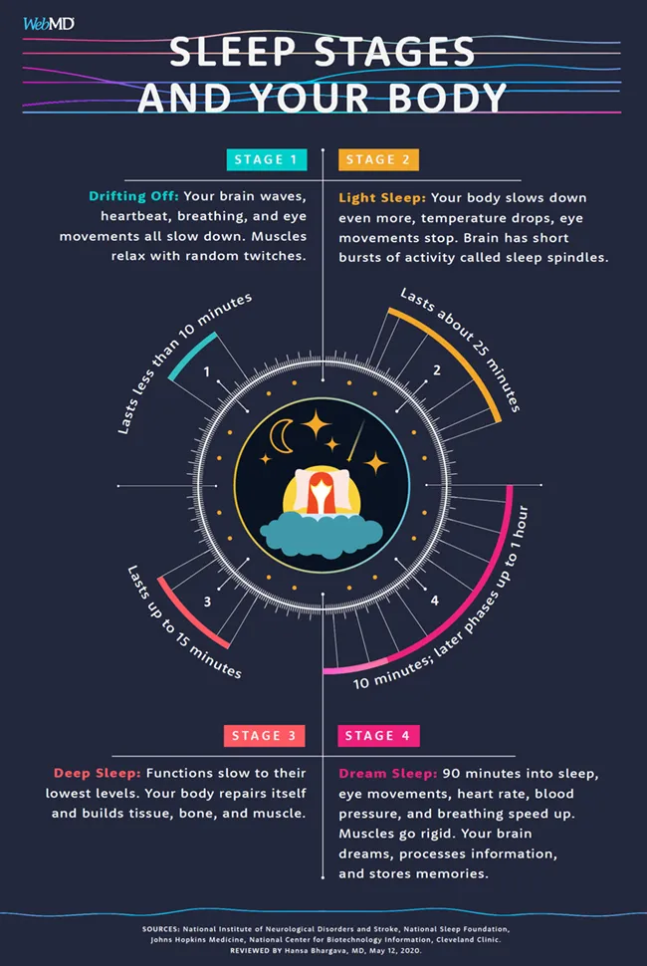
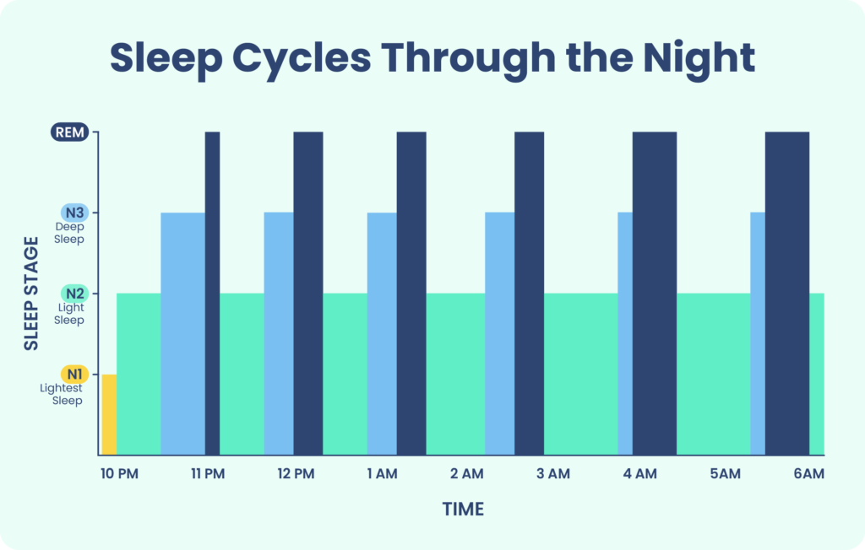
Existing Literature – Sleep Cycle variability
https://www.sleepfoundation.org/stages-of-sleep
https://www.webmd.com/sleep-disorders/sleep-101
Notes:
As we can see, this is how your sleep evolves throughout the night. Sleep tends to follow 90-to-120-minute cycles with roughly 4 to 5 cycles a night, assuming you get a full 8 hours of sleep.
At the beginning of the night, you tend to spend more time in the Light and Deep Sleep phases and less time in the REM sleep phase. However, as the night progresses, REM sleep tends to dominate over deep sleep before reaching a critical max threshold where light sleep then occupies a larger portion of your sleep cycle.
In Light sleep, you body temperature drops and eye movement comes to a halt. In deep sleep, your body’s function slow down heavily. The body is in the process of repairing itself, rebuilding tissue, bones, and muscle and starting to push memories from short into long term. In REM sleep, your body is more active, this is typically the state where dreams occur and where memory is truly consolidated from short to long term memory.

Slide 5
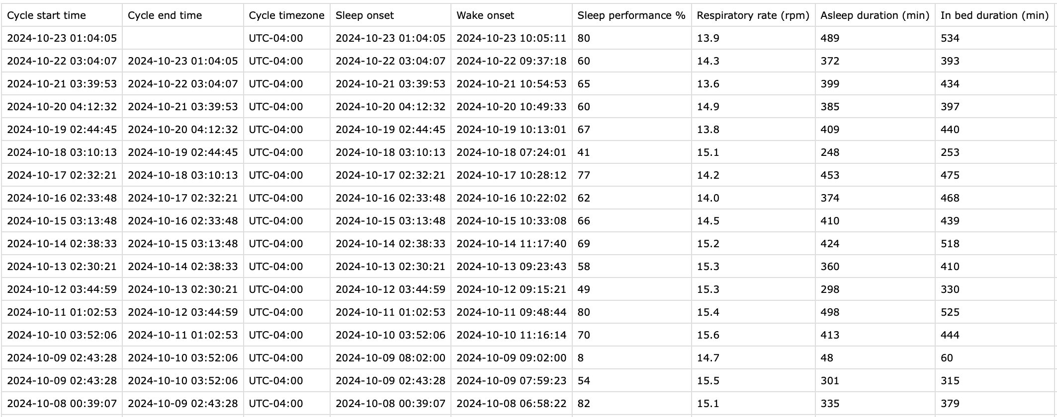
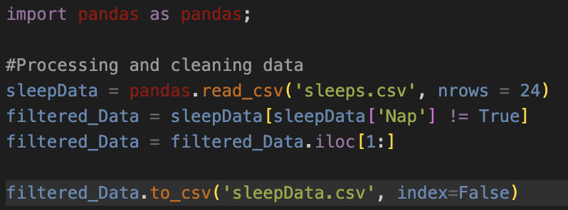
Methodology - I
Important Parameters:
Awake duration (min)
Light Sleep duration (min)
Deep (SWS) duration (min)
REM duration (min)
Asleep duration (min)
Sleep need (min)
Sleep debt (min)
Sleep Performance %
Data pre-procEssing
Raw Data:
Notes:
So first, I requested to extract the data from Whoop which gave me a CSV of all sleep data for the past month with several parameters. However, in this initial CSV, there were values such as naps that I had to get rid of as they caused data processing to be more cumbersome. There were relatively few of these naps (around 1 to 3 in the entire CSV file) so there wasn’t enough data to be statistically significant. I used the pandas python library to look through the structured data set as this was the most popular option to read CSVs and circumvented issues I might have in processing data. Additionally, I only read the first 24 rows as these were the rows with the most consistent day to day stream of data.
The most important parameters for our data analysis and processing are the Awake duration (min), the Light Sleep duration (min), Deep (Slow Wave Sleep) duration (min), REM duration (min), Asleep duration (min), Sleep need (min), Sleep debt (min), and Sleep Performance (%).

Slide 6
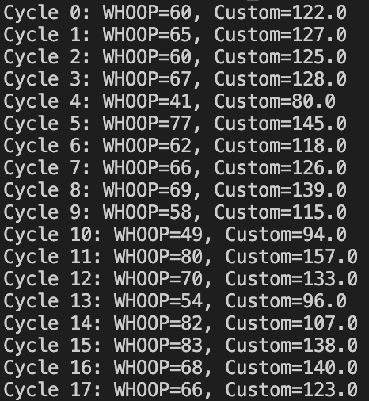
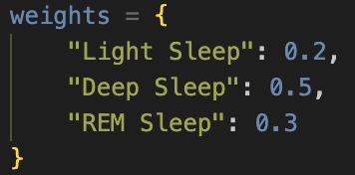
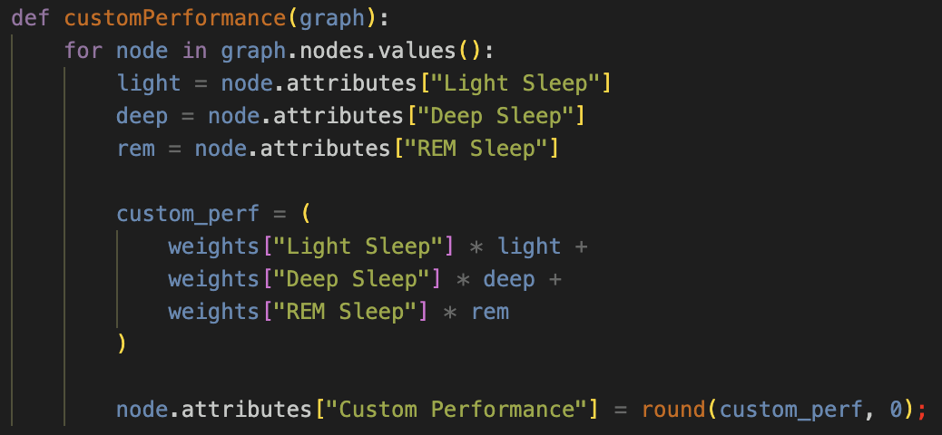
Methodology - II
Graph Data Structure; Customperformance – Iteration 1
Notes:
I first constructed a graph where each node was defined as a sleep cycle. Graphs were chosen as I could ultimately analyze the similarities and differences between each node and group nodes together based on sleep performance scores.
In the initial attempt to define a custom performance, I assigned weights to each sleep phase. Weights were defined as the importance of each sleep phase to recovery. Light Sleep is important, however not as significant as Deep Sleep or REM Sleep for recovery so it is rated at 0.2 or 20%. Deep Sleep is where your body has its most recovery, repairing and regrowing tissues that have come under strain recently. Deep sleep is also where memories are consolidated from short term memory to long term memory. The need for Deep Sleep scales with the amount of strain placed on the body, both physically and mentally. So naturally, we chose to value it at 50%. REM sleep builds on the memory consolidation that occurs in Deep Sleep but is also when your brain becomes more active and when dreams occur, so while important, it wasn’t as important as Deep Sleep, so we valued it at 30%. However, these weights proved to be ineffective as we get a custom performance significantly larger than WHOOP’s performance rating. Back to the drawing board.

Slide 7
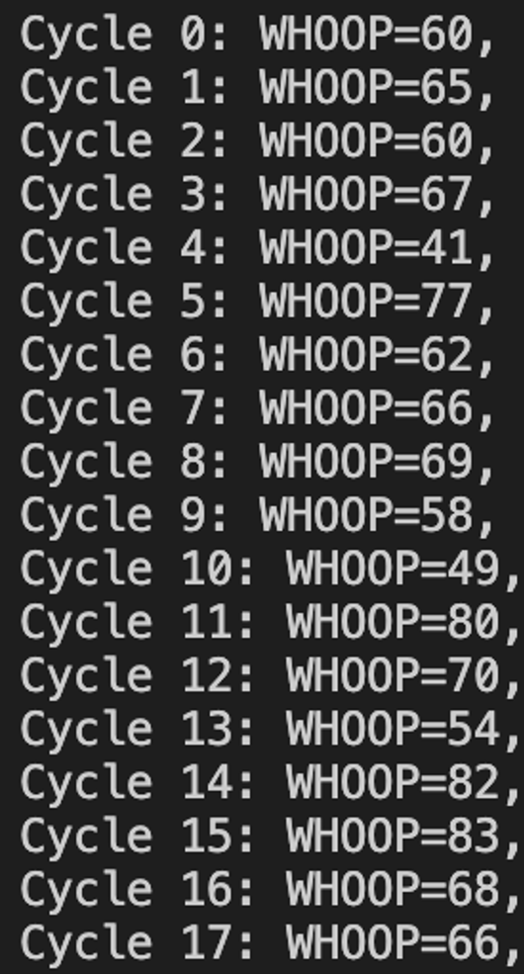
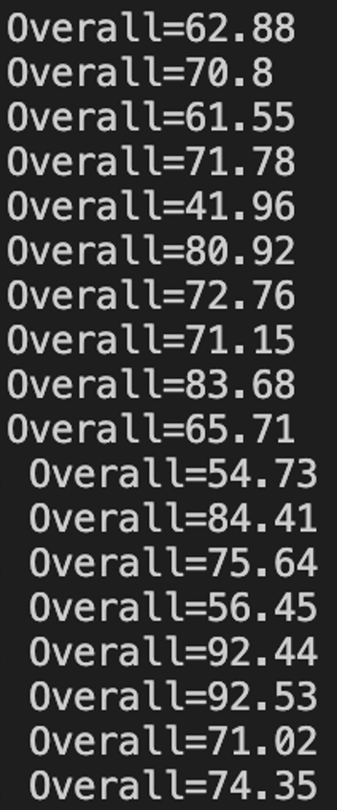
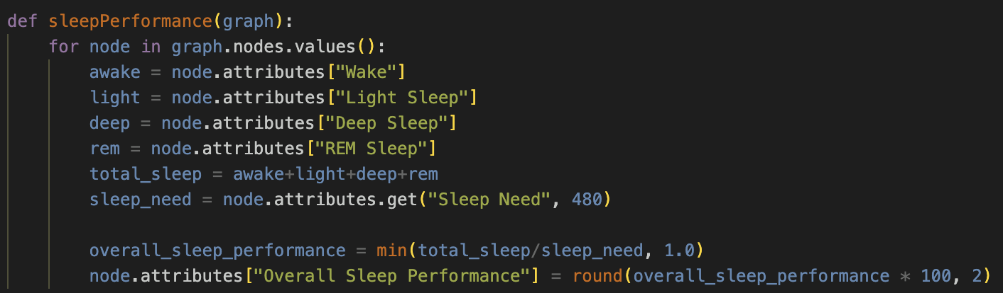
Methodology - III
Graph Data Structure; def sleepPerformance(graph):
Notes:
The next attempt instead directly compared the total amount of time spent in each sleep phase, tallied them up and compared that result with the sleep need found on the CSV file. This resulted in a significantly more accurate performance rating. However, there were some discrepancies that couldn’t be overlooked. For the first couple of cycles there isn’t as much difference between our own performance rating and WHOOP’s, however around cycle 6 we start seeing larger discrepancies, almost 10 away. Now why could that be? My first thought was it could be related to the quality of sleep during the night.

Slide 8
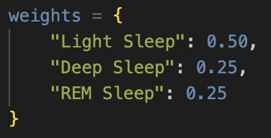
Methodology - IV
Graph Data Structure; def Compare(graph):
N1 (Stage 1) - Light Sleep (5%)
N2 (Stage 2) - Deeper Sleep (45%)
N3 (Stage 3) - Deepest Non-REM Sleep (25%)
REM (25%)
- Patel AK, Reddy V, Shumway KR, et al. Physiology, Sleep Stages. [Updated 2024 Jan 26]. In: StatPearls [Internet]. Treasure Island (FL): StatPearls Publishing; 2024 Jan-. Available from: https://www.ncbi.nlm.nih.gov/books/NBK526132/
Notes:
According to the paper Phsyiology, Sleep Stages, Light Sleep occupies 50% of sleep, whereas both Deep Sleep and REM Sleep occupy 25% each. Thus, the weights of each phase of sleep was adjusted to account for not the significance of each sleep phase to recovery but instead the amount of time spent in each.

Slide 9
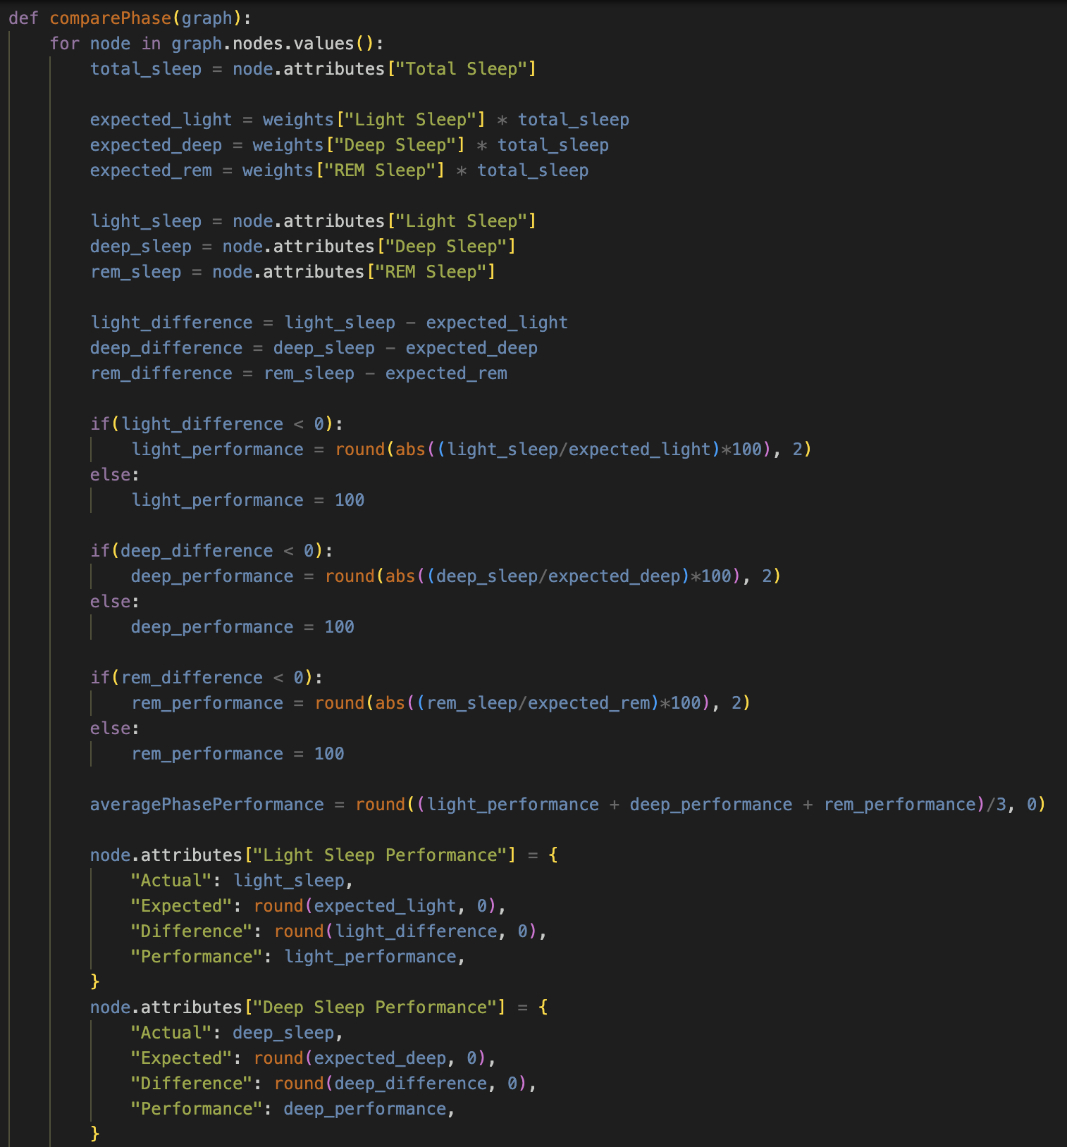
Methodology - IV
Graph Data Structure; def Compare(graph):
Notes:
These weights were then applied to each sleep phase to find out the optimal amount of time spent in each sleep phase based on overall amount of sleep. We then compare these expected values to the actual values of sleep in each phase and determine a performance rating for each.

Slide 10
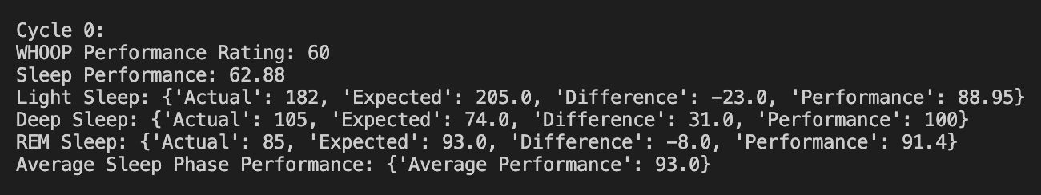
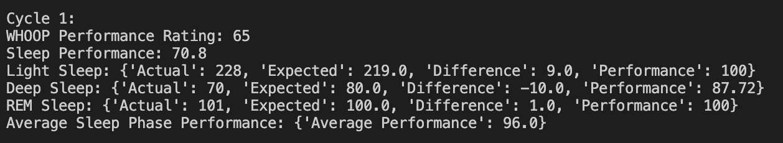
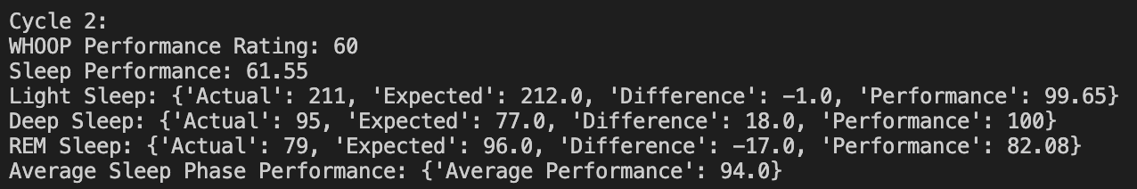
Methodology - IV
Notes:
If the difference between the actual and expected is positive, we assume the user has gotten the optimal amount of sleep in that range and conclude that performance in that sleep phase can be rated at 100%. Otherwise, if the difference is negative, we can rate the performance of the sleep phase as the ratio of actual to expected. As it is important to have optimal time in each of these phases, we can then average the three of these performances to find a total average performance for each.

Slide 11
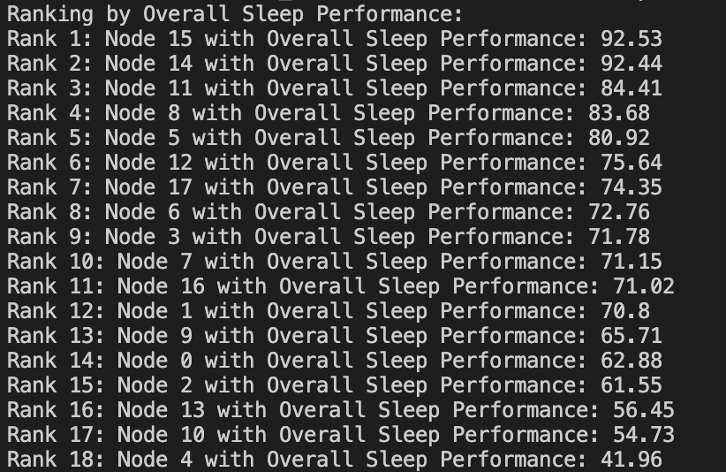
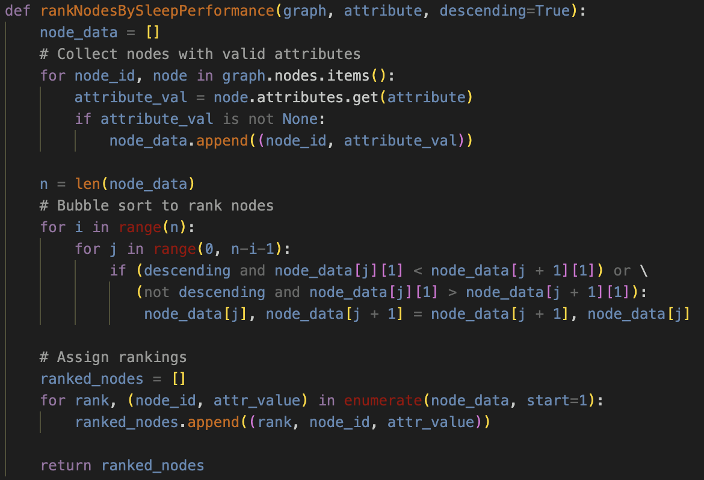
Methodology - IV
Notes:
Using bubblesort , we also ranked the nodes in descending order by the overall sleep performance rating and see if there are patterns where a high sleep rating on one day contributes to another day where sleep is supoptimal. This is seen in the sequence of Node 13 to 15. Node 13 has the third lowest sleep performance score followed by Node 14 and 15 which have the two highest sleep performance scores.

Slide 12
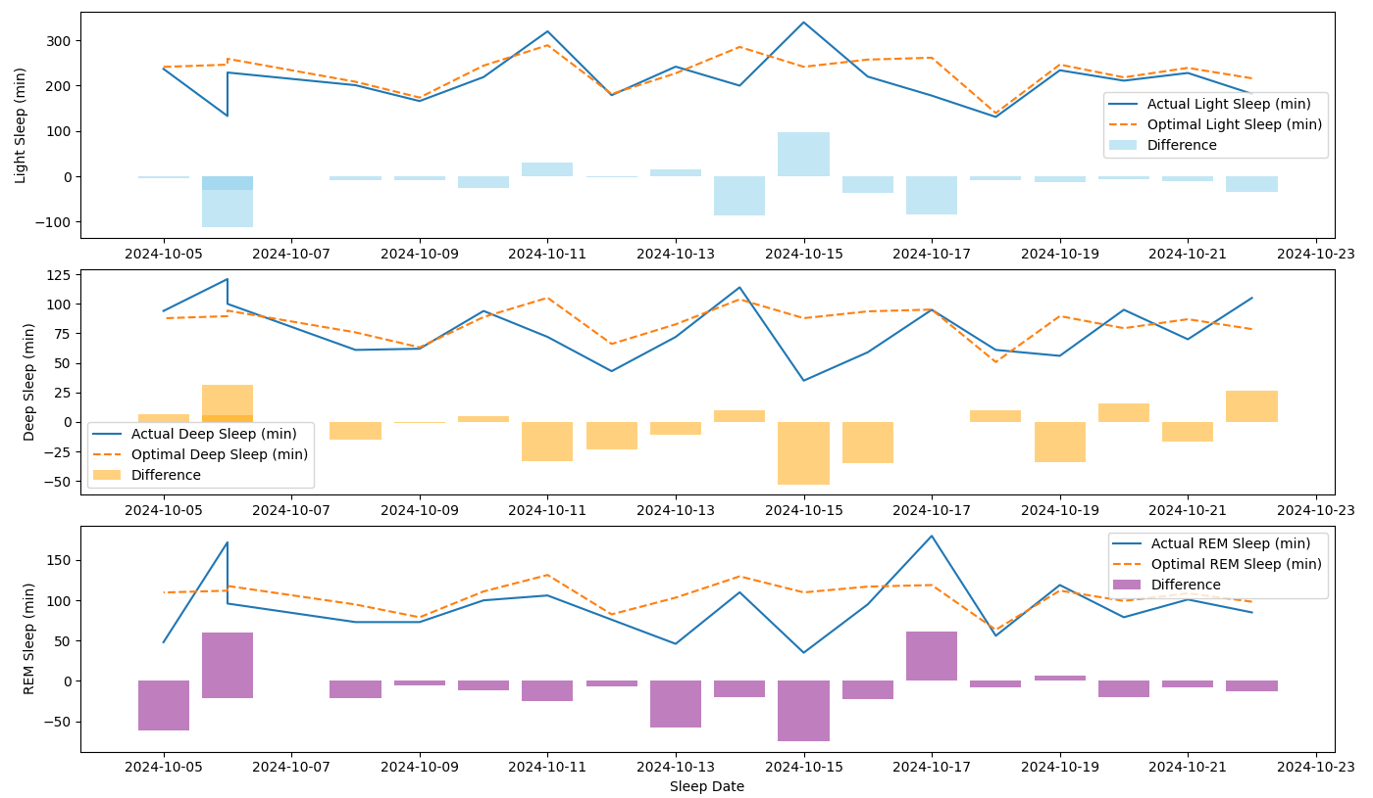
Analysis and results
Notes:
Using MatLAB, I drew up a visualization of time spent in each sleep phase. The solid line indicates what our actual data says, and dotted lines indicate optimal time spent in each phase. The bar plot in each subplot shows the difference between optimal sleep and actual sleep. The light sleep phase actual vs optimal tend to be relatively similar to each other. However, we see in the Deep Sleep and REM Sleep phase that the actual vs optimal tend to vary with actual being much lower. There are rectifying points however, where actual is greater than optimal indicating that the body makes up for lack of time spent in this phase one night by overcorrecting the next night. This helps cut down on accumulated sleep debt.

Slide 13
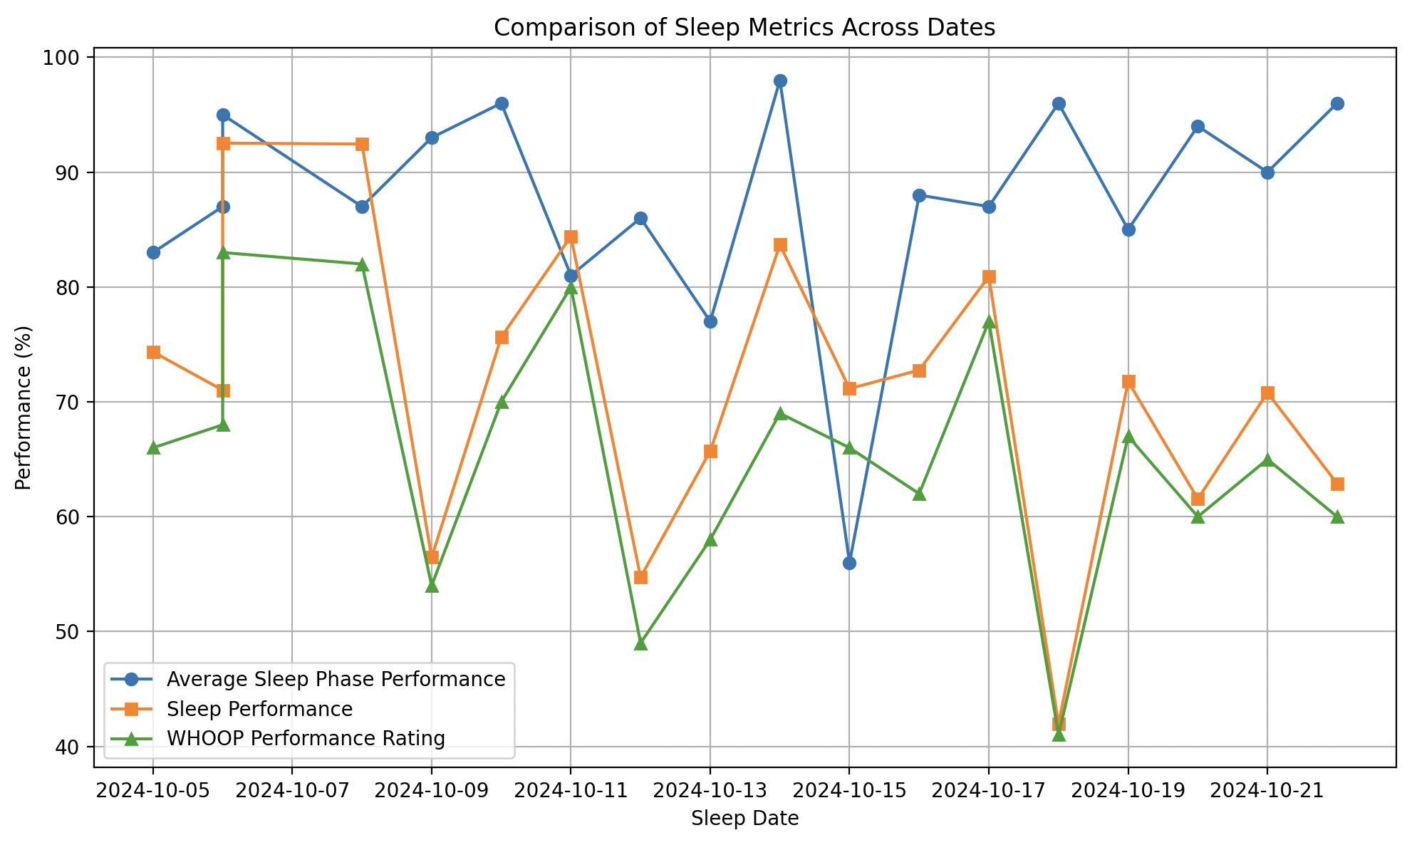
Analysis and results
Notes:
This compares the average of each sleep phase performance to the calculated sleep performance metric. WHOOP performance regularly ranks below our calculated sleep performance values. However, it doesn’t seem like average sleep phase performance is statistically significant when determining WHOOP’s performance rating. This is especially apparent in Cycle 7 where with a sleep phase performance at around 60%, WHOOP’s performance rating for that day trends higher than the previous day, even though according to our measurements, sleep performance decreased on Cycle 7. These could expose a flaw in WHOOP’s performance ranking system or indicate this rise due to an intangible, such as lower stress ratings during that day compared to the previous day.

Slide 14
Discussion
As can be seen from the previous MATLAB graph, WHOOP’s sleep performance metrics are approximated relatively accurately by just comparing the sleep need to the amount slept, but there are discrepancies in which WHOOP underrates the performance of the sleep
Could be due to taking physical strain factors into account
Limitations: No way to measure mental strain and affect it could have on amount of sleep needed
Sleep Phase Performance doesn’t seem to be statistically significant in determining WHOOP’s performance score
Notes:
While WHOOP accounts for physical strain and how it plays into recovery ratings and scores, there is significance in mental strain and how that affects sleep. If I am learning a new concept, more time needs to be accounted for in REM sleep

Slide 15
Conclusion
Performance in each sleep phase doesn’t contribute to WHOOP’s score whereas it seems like it should. However, there may be dynamic scaling for each phase as strain is calculated throughout the day.
Future Work:
Examine how strain and stress affects WHOOP’s sleep score and find a more statistically significant factor that contributes to WHOOP’s performance rating
Understand a way to quantify mental strain via its effect on heartbeat and understand its affect on a dynamic scaling solution for sleep need in each phase
Notes:
Future

Slide 16
References
https://www.whoop.com/us/en/
https://www.sleepfoundation.org/stages-of-sleep
https://my.clevelandclinic.org/health/body/12148-sleep-basics
https://www.ncbi.nlm.nih.gov/books/NBK526132/
https://www.webmd.com/sleep-disorders/sleep-101

